Slide 1

Occupational hygiene.
Physiological base of
working process
Denisov Anatoly A. PhD,docent

Slide 2
Occupational Hygiene
It studies the influence of working process and work environment on workers` health.
It elaborates hygienic standards and measures to ensure good working conditions and prevention of occupational diseases and common diseases caused by occupational activities.
Occupational hygienists applies the laboratory and epidemiological research methods:
  Laboratory research methods based on the experimental method with the assistance of laboratory animals to establish hygienic standards for work (industrial) environment factors.
  Epidemiological studies carried out by the method of monitoring of occupational health, common morbidity & mortality of workers as a result of negative influence of dangerous working factors.
Maksimenko L.V.

Slide 3
Occupational diseases
Occupational disease (OD) is the disease resulting by risk factors of labour activity (ILO, 1996).
2 million 200 thousand people die from accidents, injuries at work and OD each year all over the world (ILO).
In Russia OD due to exposure to physical factors accounted for 43%, industrial aerosols – 22% and physical stress and overwork – 19% (Report on the sanitary-epidemiological situation in Russia in 2012).
Each country - a member of the International Labour Organization (ILO) establishes a list of characteristic for the country OD and determine the preventive measures and measures for the social protection of affected employees.
The Russian OD list is based on the etiological principle and includes 150 diseases. The list of occupational diseases is regularly updated and confirmed by Order of the Minister of health of Russia.
Maksimenko L.V.

Slide 4
The name of OD is usually based on the name of the occupational harmful etiological factor:
noise disease, silicosis (SiO2), vibration disease, occupational mercury poisoning, woolsorter`s disease, housemaid's knee (prepatellar bursitis), byssinosis - rare lung disease also called "brown lung disease" or "Monday fever“, bagassosis [bag′əsō′sis] - a self-limited lung disease caused by an allergic response to bagasse, the fungi-laden, dusty debris left after the syrup has been extracted from sugarcane.
Maksimenko L.V.

Slide 5
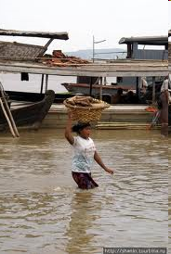
Classification of industrial hazards
I. Factors of the labor process organization
Physical heaviness (among longshoremen, porters prevalence)
Injuries, OD:
displacement of vertebras,
stretching and rupture of sheaves,
muscular pains and myopathies, hernia,
omission of an internal, omission of a uterus and vagina loss (female)
Maksimenko L.V.

Slide 6
Classification of works by
physical gravity
Class of works | Energy expenses, Kcal/h | Consumption of oxygen, l/min | Pulse, beats/min
1 - optimal | <150 | <0.5 | <90
2 -permissible | 150-250 | 0.5-1.5 | 90-120
3 – heavy | >250 | >1.5 | >120
Maksimenko L.V.

Slide 7

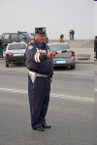
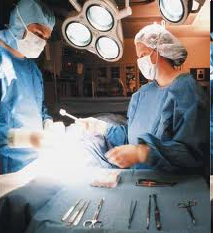
Forced standing position
Restaurant waiters, policemen, surgeons, smiths, people - walking advertizing
Impact on health: stagnation of venous blood in the extremities, peripheral nervous system diseases,
compression of the nerves, diseases of the musculoskeletal system, compression of the vertebrae.
Forced standing position in an uncomfortable position: The specific curvature of the spine - the formation of the “working hump” (surgeons), helical curvature of the spine (dentists)
Maksimenko L.V.

Slide 8
Forward head posture (FHP)
A major postural imbalance.
Anterior positioning of the cervical spine.
Common occupational hazard (it is estimated to occur in between 66%-90% of the population).
FHP produces a progressive loss and then a reversal of the normal cervical curve (lordosis) of the neck.
Changes occurring in the curvature of the spine over time due to FHP
“Working hump” (surgeons)

Slide 9
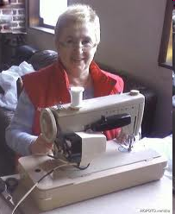
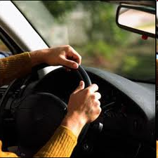
Forced sitting position
Seamstresses-machine operators, drivers of motor vehicles, computer programmers, secretaries and so on
Impact on health:
Venous congestion in the pelvic organs (hemorrhoids, menstrual disorder),
diseases of the gastrointestinal tract (constipation and their consequences –like cancer),
varicose veins,
thrombophlebitis
Maksimenko L.V.

Slide 10
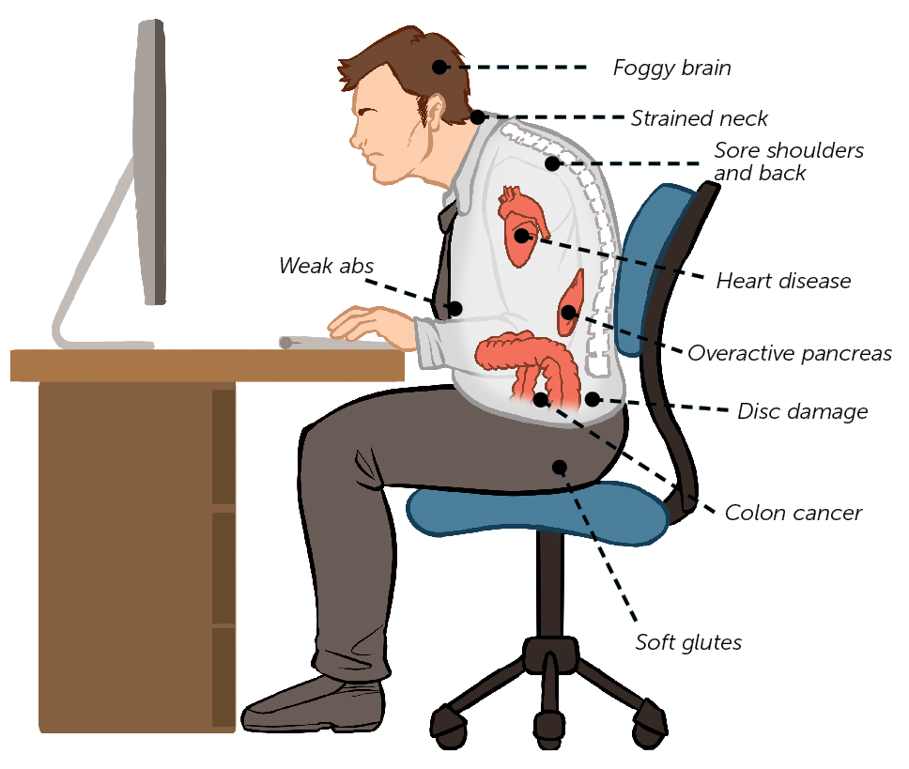
Maksimenko L.V.

Slide 11
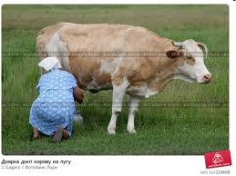
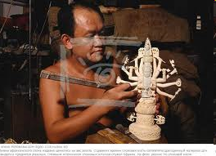
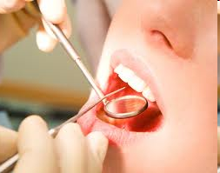
Overstrain (overworking) of individual muscles, organs and systems: small frequent movements of fingers with considerable effort
Co(-)ordinating neurosis = professional dyskinesia, chirospasm (milkmaids, carvers hard material, dentists)
Maksimenko L.V.

Slide 12
Dupuytren's contracture = Palmar fibromatosis
a consequence of chronic injury by hand tool and inflammation of the palmar aponeurosis;
scar transformation and shortening of palmar tendons

Slide 13
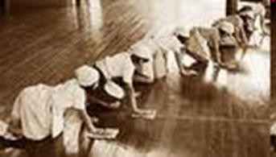
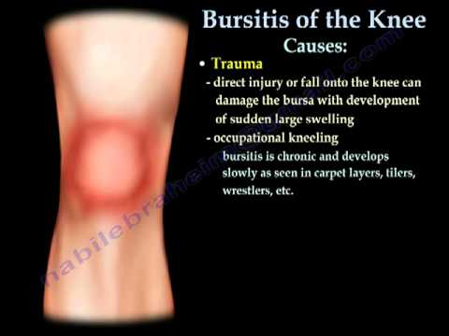
Bursitis of the knee (“housemaids` knee”)
A bursa is a fluid-filled sac that functions as a gliding surface to reduce friction between moving tissuesof the body.
There are three major bursae of the knee.
Bursitis is usually not infectious, but the bursa can become infected.
Maksimenko L.V.

Slide 14
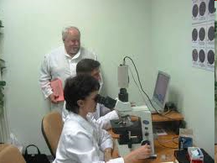

Overworking of eyes
At working with a microscope or at a small field of view (≤1 mm) there is possible development of eye overfatigue (optic nerve overstrain)→asthenopia. Ocupational myopia arises not earlier than 15-20 years of the working experience
Maksimenko L.V.

Slide 15
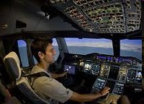

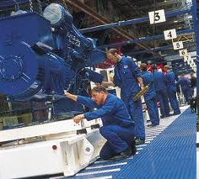
Significant mental stress
Mental stress is revealed by the work related to the need for prolonged observation, waiting, work on the assembly line, high responsibility for the health and lives of people, responsible to changing situations (pilots, doctors, ambulances and working on a conveyor system of assemblage of mechanisms).
Maksimenko L.V.

Slide 16
Physiological basis of the labor process
The basis of the professional work is a stable system of the nervous processes of excitation and inhibition in its cortical representation - "dynamic stereotype" (I.P.Pavlov) or "dominant", i.e. dominant set of points that define the execution of motor acts (A.Ukhtomsky).
Thus, dominant as functional formation in cerebral cortex determines the capacity for work.
The capacity for work (efficiency) has three phases:
  Phase of efficiency increasing
  Phase of the greatest efficiency
  Phase of fatigue.
Maksimenko L.V.

Slide 17
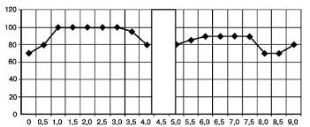
Dynamics of labor productivity during the working day
Maksimenko L.V.

Slide 18
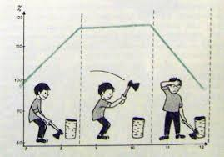
Maksimenko L.V.

Slide 20
Maksimenko L.V.

Slide 21
1) Phase of efficiency increasing
There is the generalization of all conditional reflexes as a result of repeating the labor cycles.
There is installation of body systems` coordination.
Dynamic stereotype is gradually absorbed.
The poured and moderately strong excitation of the centers responsible for the implementation of the components of the process, gradually increasing and concentrating in the cerebral cortex.
Union centers of excitability alinement.
Thus, process of formation of a dominant takes place. In process of dominant formation labor productivity increases
Duration:
5-90 min. at physical labor,
5-150 min. at mental work.
Maksimenko L.V.

Slide 22
2) Phase of the greatest efficiency
An activity of the body is harmonious and holistic.
Rhythm and velocity of individual sections of the nervous system are coordinated.
All working movements are as much as possible strong, energetically economical.
The maximum excitation in the dominant centers is accompanied by absolute absence of excitation in another locuses of the cerebral cortex.
The worker is as much as possible concentrated to work process.
Action of external irritants leads to even more concentration of attention on work and to dominant excitation..
Stability of a dominant explains "dynamic stereotype“ of I.P.Pavlov.
The duration of the phase depends on the nature of work, physical condition and working experience (≥ 2-2,5 hours).
Maksimenko L.V.

Slide 23
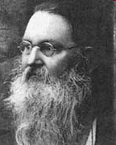
Alexey
Ukhtomsky
author of the concept of dominant
"External expression of the dominant is permanently supported work or working body position, confirmed at the moment by various stimulus, and excluding another work or another position for the moment .
Dominant centers are not the locus of the central mass, but long-term excitation in the aggregate centers”
Maksimenko L.V.

Slide 24
3) Phase of fatigue
There is dominant weakening.
The excitation spreads to other parts of the cerebral cortex.
There is protective inhibition on the place of the disappearing (former) dominante.
The coordination of functions of the central nervous system is violated.
The efficiency decreases.
Tags: deterioration of qualitative and quantitative indicators, the growth of injury in physical labor, reduction in the rate of work and increase the number of errors in mental work.
Fatigue - this is an objective process, based on the disappearance of the dominant.
Fatigue is a protective reaction.
Fatigue should not be confused with subjective tiredness.
Tiredness can occur also for another reasons: boring, unnecessary and unpleasant.
Duration of phase from several minutes to 1-1,5 hours.
Maksimenko L.V.

Slide 25

The philosophical law of unity and struggle of opposites
is expressed in DOMINANT.
Thus, at fatigue work productivity decreases.
However, reaching the fatigue in any working process is indispensable condition for increase of labor productivity after relaxation.
Maksimenko L.V.
1
Notes:
<номер>

Slide 26
Overfatigue is a pathological state
Overfatigue sets in case of continuation of work at fatigue.
Overfatigue signs:
  impossibility to fall asleep,
  faltering dream,
  returning by thoughts to an object of the labor,
  sensation of weariness to the beginning of a next working day (analogy from clinic of neurosises - a condition of extreme overexcitation)
Treatment at overfatigue: longer rest or medicamentous intervention.
Maksimenko L.V.

Slide 27
Active rest
Active rest is the most effective form of relaxation (I.M.Sechenov).
Active rest is one of the leading elements of the health-saving technologies for working peoples.
Active rest is the change of activity.
The physiological basis for active rest is a purposeful creation of another dominant.
New dominant in accordance with the properties shut down the old one.
In addition, as a rule, active rest involves the load on another body part (for physical labor) or to switch from mental to physical work (with the mental labor).
Maksimenko L.V.

Slide 28
Preventing fatigue and overfatigue
1. Organizational aspect: the organization of rational work and rest, the organization of professional training.
2. Methodological aspects: the selection of an adequate set of exercises depending on the type of work, its gravity and stresses.
3. Hygienic aspects: the organization of conditions satisfying the hygienic requirements, including allocation of special facilities for active and passive rest.
Maksimenko L.V.

Slide 29
Breaks
for lunch (30-60 min.),
regulated breaks (2-3 times on 20 min.),
5 min. every hour.
After every 1-2 work hours there should be an active rest for 5 - 15 minutes (usually at regulated breaks).

Slide 30
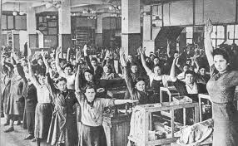
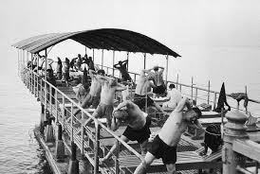
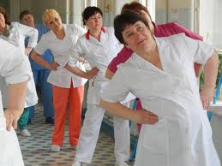
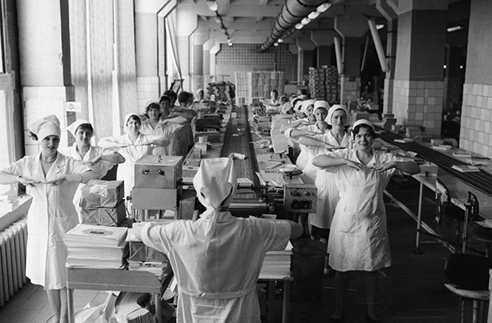
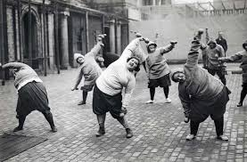
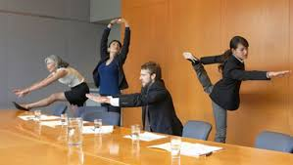
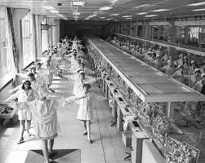
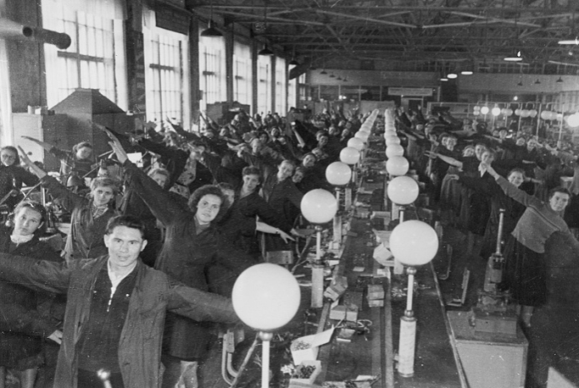
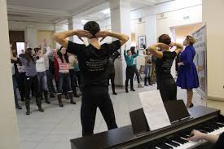
Gymnastics on working place -
the best example of active rest during the working day

Slide 31
Lab
INVESTIGATION OF THE ROLE OF ACTIVE REST (physical exercise) IN
REDUCTION OF FATIGUE
Assignments to students:
1. Measure in volunteers from among students physiological indicators of the body before and after 10 minutes of physical activity and make a table.
2. Conclude was whether the exercise active rest for the student.
Maksimenko L.V.

Slide 32
Making the protocol of the laboratory work
Method, index | Background level | Level after physical exercise | Conclusion of each index: increase / decrease
Pulse
Chronoreflexmetry: Duration of reaction to a sound (msec) Duration of reaction to flash of red color (msec) Duration of reaction to flash of white color (msec)
Tremormetry: Number of contacts Time of passage of a figure
Proof test (alphabetic test) Number of the checked up letters % of errors
Proof test (sign test) Time of check of 100 signs % of errors The conclusion that whether student physical activity played a role of active rest after the intellectual load (occupation)

Slide 33
Principle preventive measures against occupational diseases
The mainest state measures
hygienic regulation of harmful factors of working environment; sanitary control of hygiene standards
development of legislation (administrative and criminal law), aimed at punishing those responsible for its violations
Technical measures
1. Changes on the technology
2. Improvement of the equipment
Organizational measures
3. Organization of a mode of work and rest, observance of the regulated breaks and lunch breaks, the rational organization of a workplace, providing by premises for a relaxation, food acceptances
Sanitary measures
4. Introduction of sanitary-engineering systems (ventilation, water supply, heating or air-conditioning, the water drain, noise isolation, isolation of the vibrating tool, screens from ionizing radiation, Isolation of infectious patients in boxes…)
The purpose
1. To eliminate the harm factor
2. To lower intencity of the harm factor
3. To create health caring working process
4. To create favorable working conditions and to lower intensity of risk factor
Maksimenko L.V.

Slide 34
5. Maintenance with working clothes and means of individual defense taking into account operating factors of harm
Medical measures
6. Preliminary routine medical inspection at employment
7. Regular medical inspections by a special commission of doctors which speciality and the list of obligatory medical researches is defined by harm factors of workplaces.
8. Physiotherapy in a dispensary, policlinic of the industrial enterprise, establishment …).
9. Maintenance with the medical-and-prophylactic food ration (the diet should be soundly appointed by the doctor of a medicosanitary part and it is given at the expense of the employer).
10. Recommendations of the doctor about a balanced diet in home conditions with correction according to the harm factor
11. Recommendations of the doctor about a healthy way of life, about rules of independent preventive maintenance within the working day
5. To protect a body both damaged systems and organes (a working helmet, a respirator, UV - or IR-radiation glasses, antiphons and berushis, special gloves for protection against vibration, an antiradiational apron...)
6. To refuse in employment with professional risk in case of already available disease of damaged organs, that will lower risk of OD
7. To find out OD as soon as possible for successful treatment and physical inability preventive maintenance
8. To support normal functioning of organs and systems by physiotherapeutic methods
9, 10. To correct a condition of damaged organs and systems by food, to protect them and to promote their restoration
Maksimenko L.V.

