Slide 1
Hygiene of the educational process

Slide 2
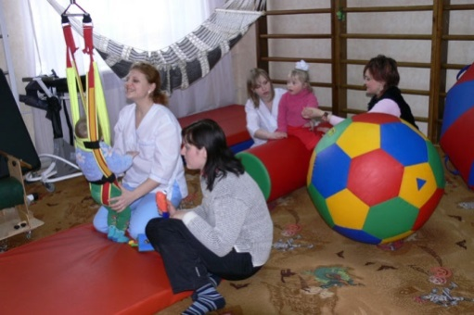
Hygiene requirements for the planning, development, equipment pre-school institutions and schools
The basic principles of hygienic design of pre-school institutions are:
- Compliance group isolation;
- Creating a favorable air-thermal;
- Ensure optimal lighting and insolation;
- Ensure the physical activity of children;
- Creation of conditions for sustainable food;
- Indoor applications.

Slide 3
The basic principles of hygienic design schools are:
- Providing an enabling environment for the educational process;
- Ensure optimal light regime;
- Creating conditions for physical education;
- Creating conditions for Guidance;
- Ensure the rational organization of food
students;
- Create conditions for recreation for children and adolescents;
- Creation of conditions for organization of cultural and media work.

Slide 4
Children's Institutions
To child care are:
kindergartens (nursery, kindergarten)
children's education (secondary and special schools - high school, grammar school - a different type) and
Extracurricular (palaces, homes of children and youth, summer camps) institutions.

Slide 5
Radius service child care
preschool radius service should be 0,3-0,5 km
school children - to 0.5 km
secondary school students - up to 1 km;
schoolboys - to 1.5 km
in rural areas (subject to the organized transportation of children specially selected and suitable transport) - up to 3 km.

Slide 6
Requirements for land
Land must meet hygiene standards, they should:
place in an environmentally most suitable places
at some distance from sources of air pollution,
Noise and major transport arteries.

Slide 7
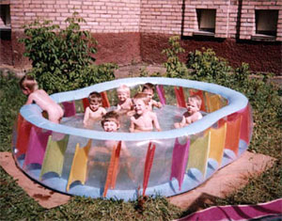
In the land pre-school institutions should provide:
availability of group areas for children of all ages
general athletic venues,
garden, berries,
the economic zones and walkways.

Slide 8
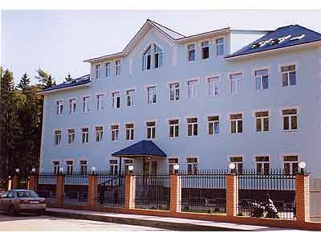
Modern types of schools
To modern types of schools include:
initial,
basic and secondary schools,
school and high school.

Slide 9
Buildings educational institutions is carried out in three major systems:
compact (centralized)
block (sectional)
pavilions (decentralized).

Slide 10
Functional Area School
In areas of the institution should be located following functional areas:
study,
educational research (educational-production)
sport,
economic,
Housing (if dormitories, sleeping buildings, etc.)
recreation area.

Slide 11
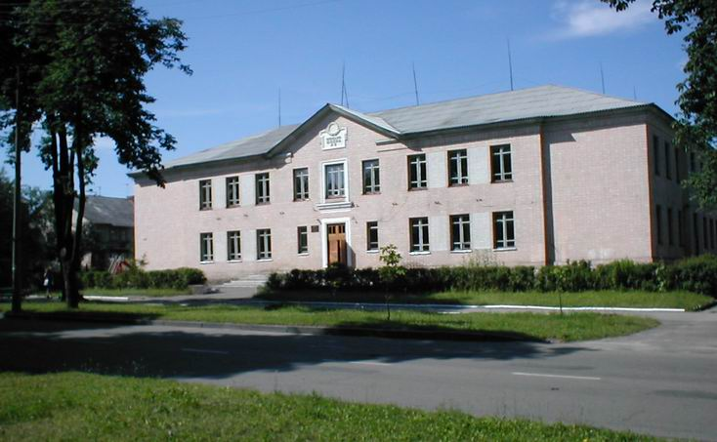
The height of buildings in secondary schools should not exceed three to four floors

Slide 12
Floor height should be not less than 3.6 m.
height of lecture rooms (50 seats or more), assembly halls, sports and sports facilities - not less than 4.2 m.

Slide 13
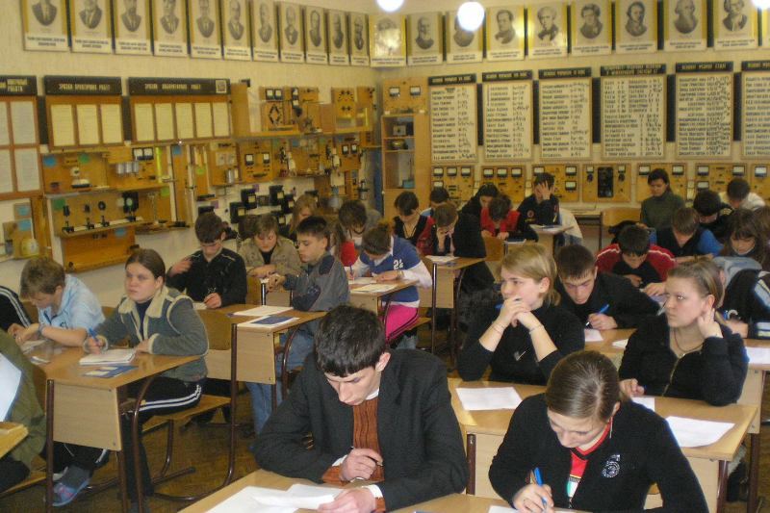
The buildings should be included 3 groups of rooms in school :
basic (training rooms, classrooms, laboratories, educational workshops, gym)
support (library, recreation room, dining room, snack bar, conference hall, pantry, storage facilities, toilets, etc.).
services (for administrative offices, teachers', medicine cabinet, etc.). room.

Slide 14
Requirements for Classroom
The best form of classroom - rectangular (depth 6-6,3 m in length - 8-8,4 m) of depth to width ratio of 3:4.
The distance from the first row of desks to the board should be 1.6 - 2 m, ceiling height - P-3, 5 pm Location ups - nearside, consider the angle (angle between the line of sight and plane blackboard in the horizontal plane) must be at least as З0 ° -35 °.

Slide 15
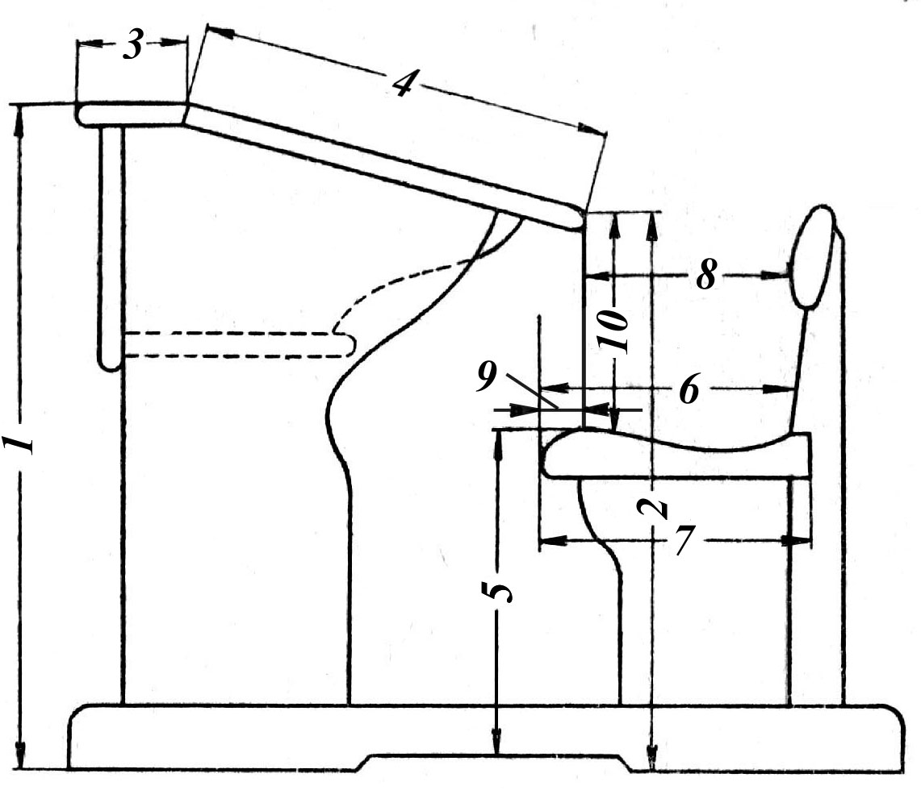
The main dimensions of school desks
(1 - height of the front end of the table 2 - the height of the rear end of the table, 3 - horizontal width of the lid, 4 - the width of the oblique caps, 5 - the height of the seat 6 - seat depth, 7 - seat width, 8 - distance back;
9 - seating distance 10 - dyferention

Slide 16
Distance of seat
Seating distance (the distance from the rear end of the table to the front edge of the seat in the horizontal plane) must be negative, ie, seat chair has come for an end table for 3-4 cm (group A), a 5-cm (group B and C) and 7.8 cm (group D).

Slide 17
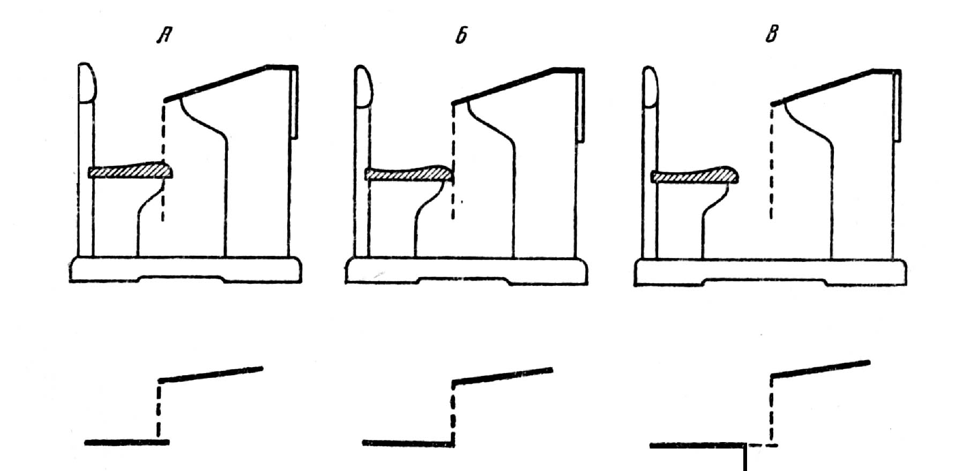
Different kinds of seating distance
(A - negative; B - zero, 8 - positive)

Slide 18
Differention
Differention (distance from rear edge of the table to seat in the vertical plane) is greater than at 5-6 sm distance from plane seat to elbow freely lowered hands schoolboy sitting.

Slide 19
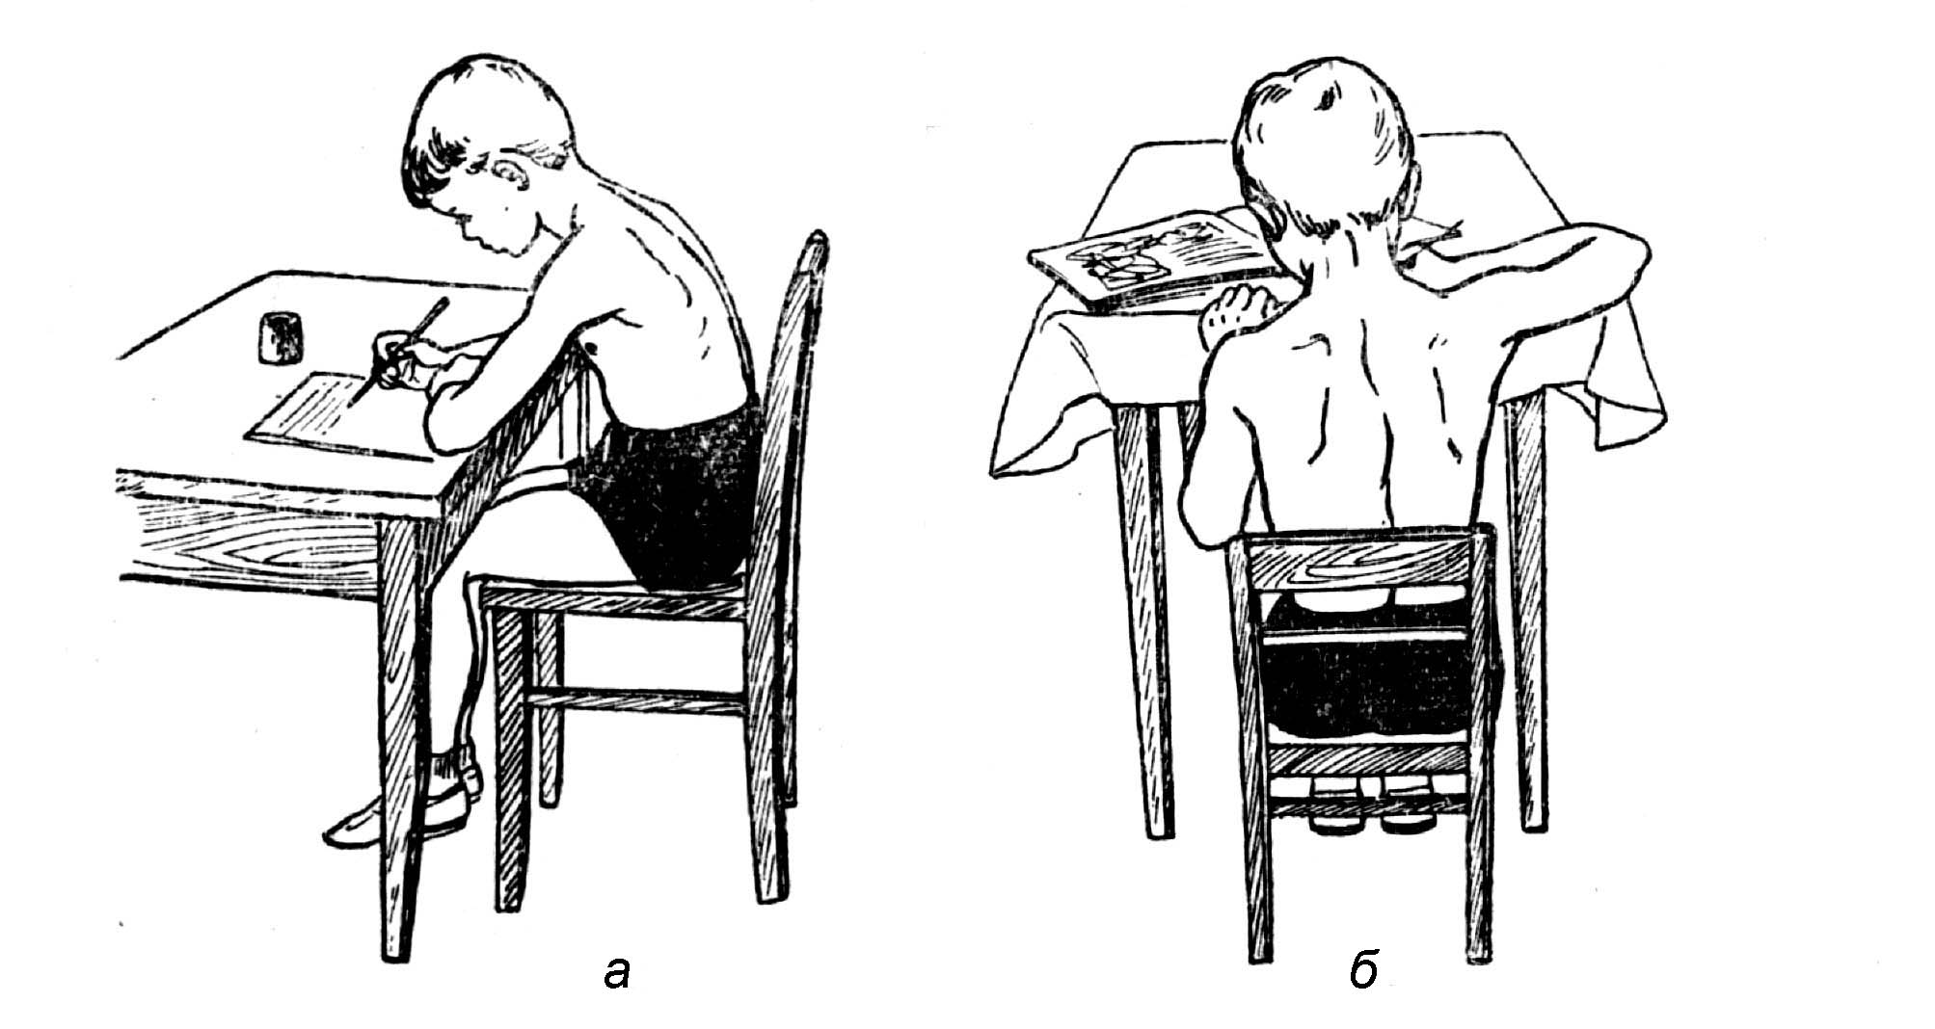
Body position at small (a) and large (b) the amount of differention

Slide 20
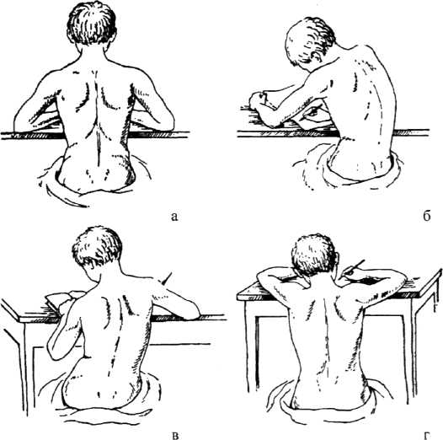
Right and wrong landing
Proper (s) and landing wrong (would-seat lower table, in Mr. seats for the high table).

Slide 21
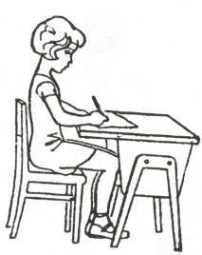
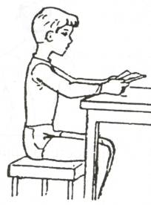
Correct:

Slide 22
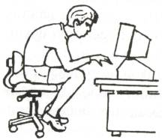
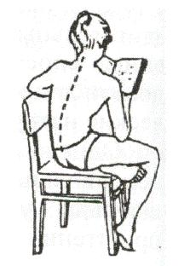
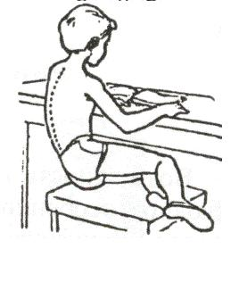
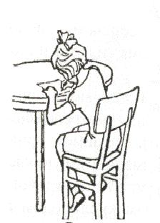
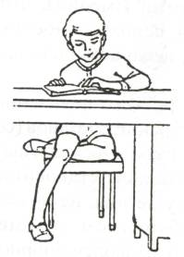
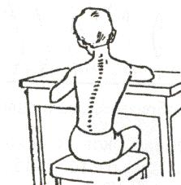
Incorrect:

Slide 23
Hygienic evaluation of educational work in school.
Hygienic evaluation of the NPT regime, the schedule of classes and lessons.
The research necessary to obtain information: availability and duration of the day, the main mode of regime elements
accuracy and efficiency of their interposition
compliance with health, age, sex, anatomic and physiological and functional features of the organism and the individual inclinations of the child.

Slide 24
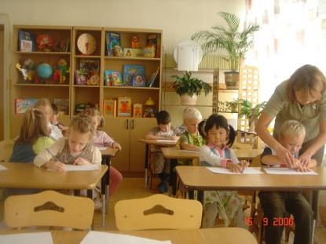
Control of educational arrangement associated with timing of classes in school, length of lessons, breaks between them and the changes under the number of lessons during the year and week curriculum.

Slide 25
Hygienic evaluation of lesson
Hygienic evaluation of lessons to study the conditions for its implementation, features of presentation of teaching material, teaching methods and visibility, degree of fatigue of students during the educational process of hronometric observation period of major structural elements of the lesson (of the organization, checking homework, most often the consolidation of new material, the last part).

Slide 26
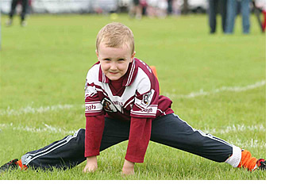
Hygienic assessment of the lesson of physical culture
To assess the hygienic characteristics of the lesson of physical culture and should be referred for observation hronometrazhnyh (vvodna. preparatory, primary (the formation of motor skills and moving the game) and the final part), determine the total motor density and lessons as well as a physical training of children, creation of physical and physiological curves load, using functional tests (canting test, Martin-Kushelevsky test, sample dosed with muscle strain, a modified test Letunova etc.), control of air-thermal regime of school environment.

Slide 27
Sanitary-hygienic assessment lesson employment training
Sanitary-hygienic assessment lesson employment training school provides for hronometric observations, monitoring the nature, mode and conditions of training, determine equipment workshops growth of students, assessment of functional status of children and adolescents in the course of employment.

Slide 28

Sanitary examination process printing of school textbooks
Sanitary examination process printing school textbooks for determination
general information about the manual
characteristics of
paper
Font
set
Print
appearance
laboratory studies

Slide 29
Surgical examination of children's toys
Surgical examination of children's toys leads to the necessity to define the general information about the toy, its size, weight, shape and strength, material from which it is made, smell, strength of fixation of dyes, the characteristics of optical properties, strength, sound, electric power and tension of bacterial contamination of the product.

